Slide 1
Spring Boot
Banuprakash C
banu@lucidatechnologies.com
banuprakashc@yahoo.co.in

Slide 2

Enable Caching
EnableCaching annotation would register the same ConcurrentMapCacheManager.
There is no need for a separate bean declaration for CacheManager.

Slide 3
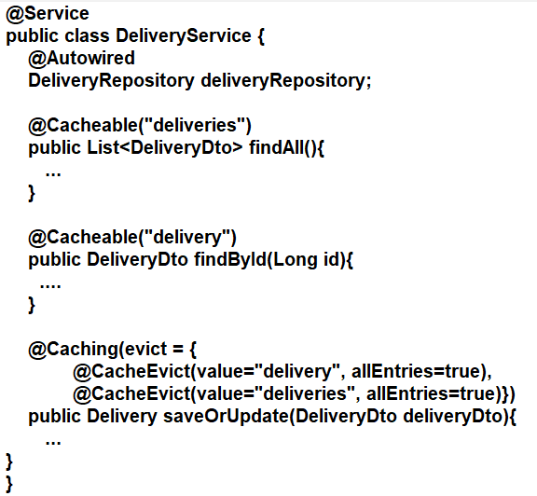
Enable Caching
@Cacheable
enable caching behavior with the name of the cache where the results would be stored
@CacheEvict
removal one or more/all values – so that fresh values can be loaded into the cache again

Slide 4
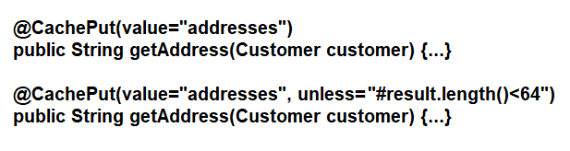
Enable Caching
@CachePut
update the content of the cache without interfering the method execution. That is, the method would always be executed and the result cached

Slide 5
Spring Data JPA
Spring Data JPA @Modifying Annotation
The @Modifying annotation is used to enhance the @Query annotation to execute not only SELECT queries but also INSERT, UPDATE, DELETE, and even DDL queries.
@Modifying@Query("update User u set u.active = false where u.lastLoginDate < :date")void void deactivateUsersNotLoggedInSince(@Param("date") LocalDate date);
@Modifying(clearAutomatically = true)
persistence context is cleared after our query execution
@Modifying(flushAutomatically = true)
the EntityManager is flushed before our query is executed.

Slide 6
Spring Data JPA Query Projections
Scalar Projections
Allows you to select entity attributes instead of fetching the entire entity
@Query(“SELECT name, price from Product”)
List<Object[]> getNameAndPrice()
DTO Projections
Create a DTO class and use constructor expression in query
@Query(“SELECT new com.banu.prj.ReportDTO(c.email, o.orderDate, o.total) from Order o left outer join o.customer c”)
List<ReportDTO> getReportDTO()

Slide 7
Spring Data JPA Query Projections
Derived Query without constructor expression
Write DTO class with only one constructor and parameters matching names of entity class attributes, spring generates a query with required constructor expression
List<ProductDTO> findByName(String name);
DTOs as interface
Instead of defining a class, we can use interface with only getters as DTO projection
public interface ProductDTO {
String getName();
String getPrice();
}

Slide 8
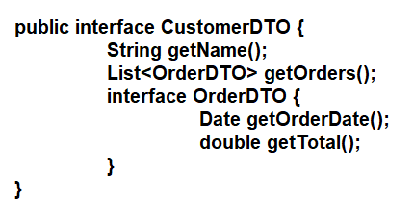
Spring Data JPA Query Projections
Nested Associations
Spring Data maps List of orders to OrderDTO
This uses n+ 1 select

Slide 9
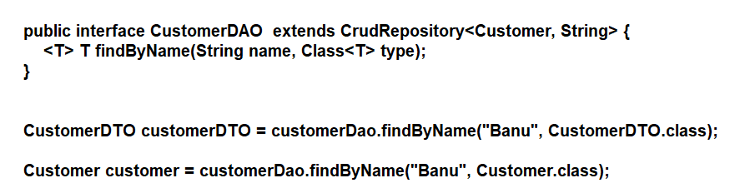
Spring Data JPA Query Projections
Dynamic Projections
Depending on the class you provide when you call the repository method, Spring Data JPA uses one of the different mechanism to define the projection and map it

Slide 10
Spring Data JPA Query Projections
Using Spring’s Expression Language

Slide 11
Pagination
Paginating the Query Results of Our Database Queries
We can paginate the query results of our database queries by following these steps:
Obtain the Pageable object that specifies the information of the requested page.
We can create it manually.
We can use Spring Data web support.
Pass the Pageable object forward to the correct repository method as a method parameter.

Slide 12
Pagination
Slice and Page
Page is just a sub-interface of Slice with a couple of additional methods.
A Page contains information about the total number of elements and pages available in the database. It is because the Spring Data JPA triggers a count query to calculate the number of elements.
To avoid this costly count query, you should instead return a Slice. Unlike a Page, a Slice only knows about whether the next slice is available or not. This information is sufficient to walk through a larger result set.
You should use Slice if you don't need the total number of items and pages. A good example of such a scenario is when you only need Next Page and Previous Page buttons.

Slide 13
Query by Example
The Query by Example API consists of three parts:
Probe: The actual example of a domain object with populated fields.
ExampleMatcher:
The ExampleMatcher carries details on how to match particular fields. It can be reused across multiple Examples.
Example:
An Example consists of the probe and the ExampleMatcher. It is used to create the query.
Query by Example also has several limitations:
No support for nested or grouped property constraints, such as firstname = ?0 or (firstname = ?1 and lastname = ?2).
Only supports starts/contains/ends/regex matching for strings and exact matching for other property types.
Query by Example is well suited for several use cases:
Querying your data store with a set of static or dynamic constraints.
Frequent refactoring of the domain objects without worrying about breaking existing queries.
Working independently from the underlying data store API.

Slide 14
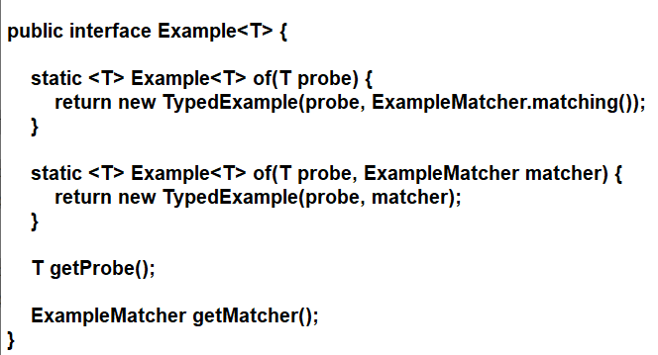
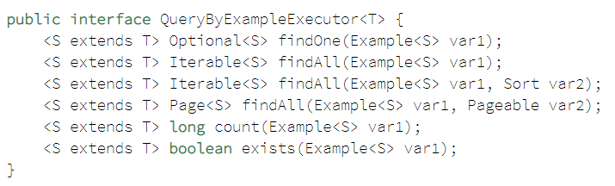
Query by Example
QueryByExampleExecutor interface to support query by example:

Slide 15
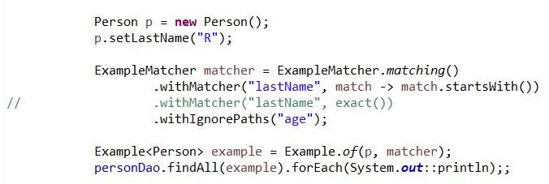
Query by Example
import org.springframework.data.domain.Example;
import org.springframework.data.domain.ExampleMatcher;
import static org.springframework.data.domain.ExampleMatcher.GenericPropertyMatchers.exact;

Slide 16
SpEL support in Spring Data JPA
#{#entityName}
To avoid stating the actual entity name in the query string of a @Query
@Query("select u from #{#entityName} u where u.lastname = ?1")
List<User> findByLastname(String lastname);
@Entity
public class User {
@Entity(name = "MyUser")
public class User {

Slide 17
SpEL support in Spring Data JPA
SpEL for LIKE expressions
When using like-conditions with values that are coming from a not secure source the values should be sanitized so they can’t contain any wildcards and thereby allow attackers to select more data than they should be able to.
For this purpose the escape(String) method is made available in the SpEL context.
It prefixes all instances of _ and % in the first argument with the single character from the second argument.
List<Employee> emps = employeeDao.searchByName("Raj_ev");

Slide 18
Spring Boot JPA entity graphs
Applying the Entity graphs fetches the mapped entities eagerly while querying the database.
We can use Entity graphs to eliminate the N+1 select query problem.
Entity graph fetch types
FetchGraph: Applying this fetch type results in fetching all the entity graph attribute nodes eagerly. Other mapped entities will be lazily fetched irrespective of the specified fetch type.
LoadGraph: Applying this fetch type results in fetching all the entity graph attribute nodes eagerly. Other mapped entities are treated based on the default/specified fetch type.

Slide 19
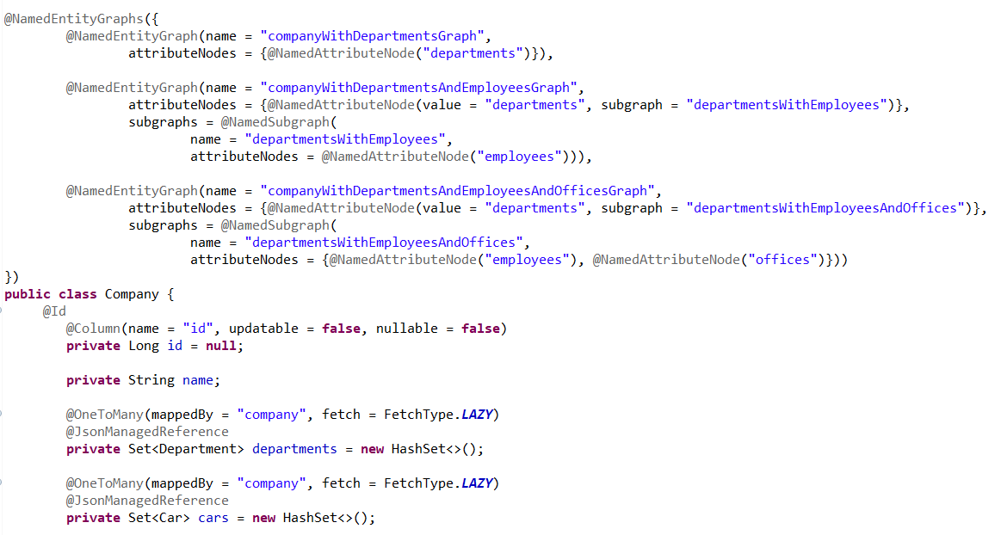
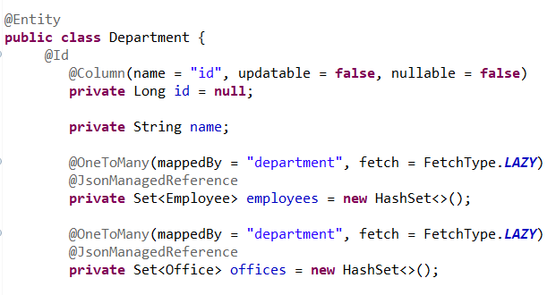
Spring Boot JPA entity graphs

Slide 20
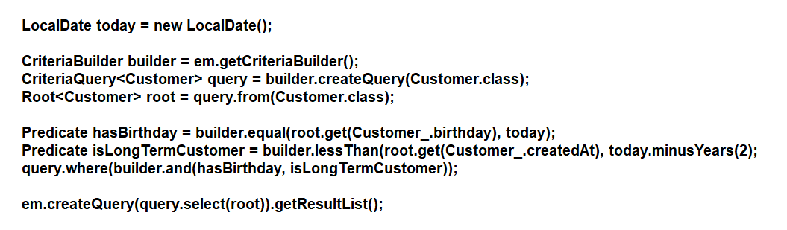
Spring Data JPA Specifications
Criteria API
Criteria API offers a programmatic way to create typed queries, which helps us avoid syntax errors
Use case: send a voucher to all long term customers on their birthday’s

Slide 21

Spring Data JPA Specifications
Specifications
To reuse Predicate

Slide 22
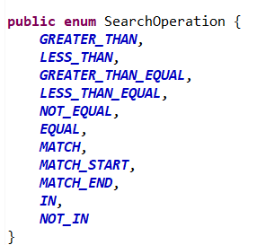
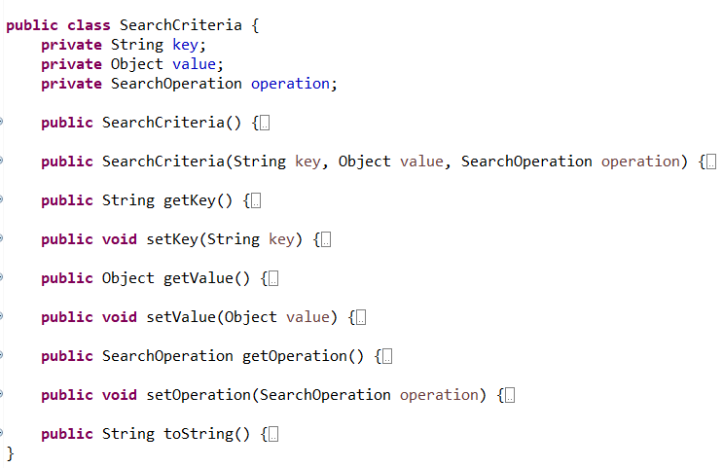
Spring Data JPA Specifications
Example

Slide 23
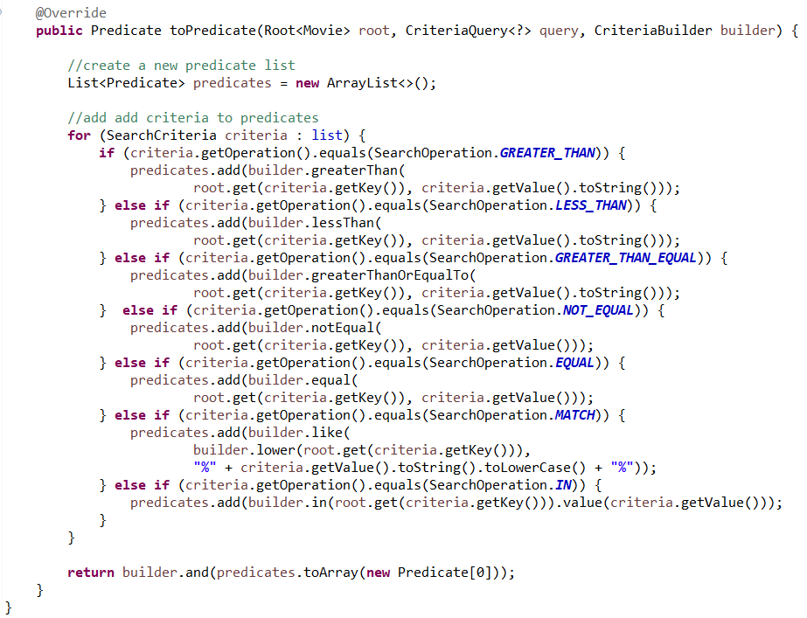
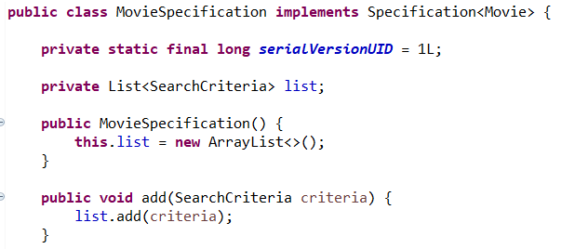
Spring Data JPA Specifications: Specific implementation

Slide 24

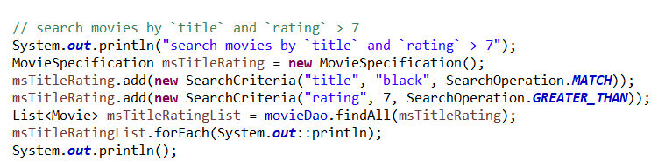
Spring Data JPA Specifications
To execute specification we need to extend dao repository interface with JpaSpecificationExecutor

Slide 25
Spring Data — Envers
Maintain the data versioning info
Hibernate Envers project aimed to track data changes at the entity level with easy configurations in properties level and entity class level using annotations
The spring-data-envers project builds on top of Hibernate Envers and comes up as an extension of the Spring Data JPA project

Slide 26
Spring Data — Envers
Add the following dependency:
<dependency>
<groupId>org.springframework.data</groupId>
<artifactId>spring-data-envers</artifactId>
</dependency>

Slide 27
Spring Data — Envers
Add the @Audited annotation either on an @Entity (to audit the whole entity) or on specific @Columns (if you need to audit specific properties only)
@Entity
@Audited
public class Post {
@OneToMany()
@Audited
private Set<Comment> comments;
@ManytoOne()
@NotAudited
private Set<Comment> comments;
}

Slide 28
Spring Data — Envers
audit tables:
<EntityName>_AUD (if you've set EntityName as @Audited) table should be generated automatically.
The audit tables copy all audited fields from the entity's table with two fields, REVTYPE (values are: “0” for adding, “1” for updating, “2” for removing an entity) and REV.
Besides these, an extra table named REVINFO will be generated by default, it includes two important fields
REV and REVTSTMP and records the timestamp of every revision.

Slide 29
Spring Data — Envers
We can customized audit table prefix, suffix, and a few other naming conventions by changing the following properties.
Spring.jpa.properties.org.hibernate.envers.audit_table_prefix
Spring.jpa.properties.org.hibernate.envers.audit_table_suffix (Default value _AUD)
Spring.jpa.properties.org.hibernate.envers.revision_field_name (Default value — REV)
Spring.jpa.properties.org.hibernate.envers.revision_type_field_name — (Default value — REVTYPE)

Slide 30
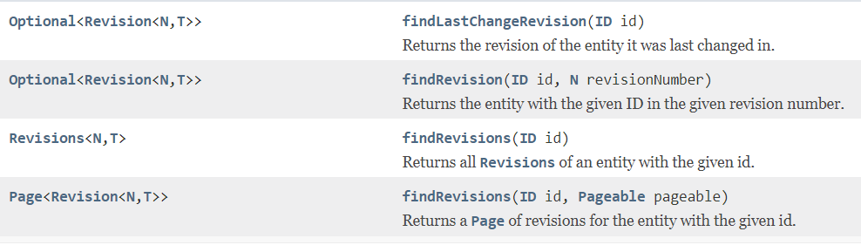
Spring Data — Envers
Repository interface
RevisionRepository<T,ID,N extends Number & Comparable<N>>
By implementing RevisionRepository allows the following 4 different methods to get versioning information:

Slide 31
Spring Data — Envers
EnversRevisionRepositoryFactoryBean
FactoryBean creating RevisionRepository instances.
Integrating spring-data-envers project to your Spring Boot project.
@SpringBootApplication
@EnableJpaRepositories(repositoryFactoryBeanClass = EnversRevisionRepositoryFactoryBean.class)

Slide 32
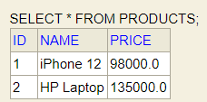

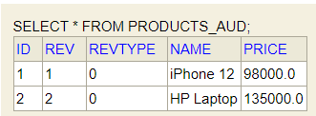


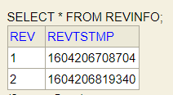
Spring Data envers
Tables on inserting products

Slide 33
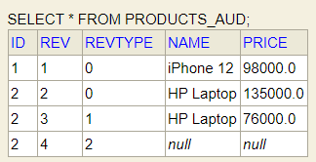
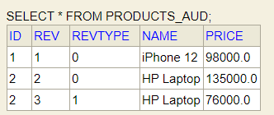
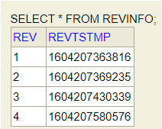
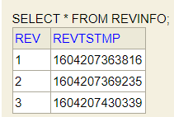
Spring Data envers
Updating a product
Deleting a Product

Slide 34
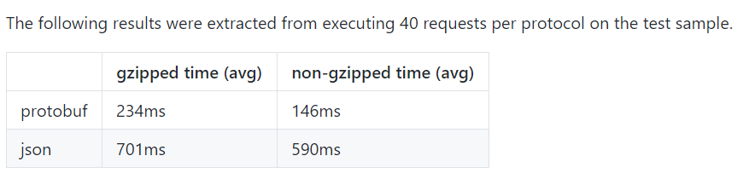
Protocol buffers, or Protobuf
Binary format created by Google to serialize data between different services.
It provides support, out of the box, to the most common languages, like JavaScript, Java, C#, Ruby and others
Protobuf performs up to 6 times faster than JSON
Two Java backends communicating results

Slide 35
Protobuf
Protobuf is more than a message format, it is also a set of rules and tools to define and exchange messages.
Protobuf has more data types than JSON, like enumerates and methods, and is also heavily used on RPCs (Remote Procedure Calls).

Slide 36
How Do We Use Protobuf?
Protobuf has three main components that we have to deal with:
Message descriptors: we have to define our messages structures in .proto files.
Message implementation: We have to generate classes/objects to deal with data in the chosen programming language.
Parsing and Serialization. After defining and creating Protobuf messages, we need to be able to exchange these messages.

